Slide 1
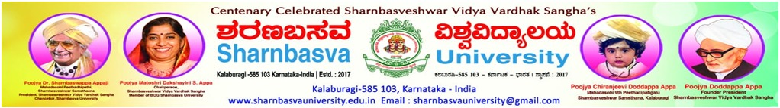
FACULTY OF COMPUTER APPLICATIONS (MCA)
2022-2023
A Presentation on
“FAKE CURRENCY DETECTION USING MACHINE LEARNING”
Submitted By :
Abishek Datta Jagtap
(SG21MCA002)
Under the Guidance of:
Dr. Shrikant M Patil

Slide 2
FAKE CURRENCY DETECTION USING MACHINE LEARNING

Slide 3
Outline
Abstract
Introduction
Problem statement
Aim
Existing system
Proposed system
Feasibility study
System environment
Modules
System design
Form Design
Conclusion

Slide 4
Abstract
Fake bank currency poses a significant threat to our country's financial system. During demonetization, a large amount of counterfeit money was found in circulation. Distinguishing fake notes from genuine ones is challenging due to their similarity. An automated system using machine learning can aid in identifying forged bank currency efficiently.
Six supervised machine learning algorithms are used for banknote authentication. The algorithms employed are: K-Nearest Neighbors (KNN), Decision Tree, Support Vector Machine (SVM), Random Forest, Logistic Regression, and Naive Bayes. Additionally, the LightGBM algorithm is also used.

Slide 5
Introduction
In our fast-paced financial world, banknotes play a critical role as a valuable asset of our country.
However, counterfeit notes are being introduced into the market, closely resembling genuine ones, causing financial discrepancies.
Human detection of forged bank currency is difficult due to the high precision with which fraudsters create fake notes.
Government-designed features on banknotes help identify genuine ones, but counterfeiters mimic these features with great accuracy.
To combat this problem, an automated system using machine learning can be implemented in banks and ATMs.
The goal is to design an automated system to determine the legitimacy of banknotes.
By inputting the physical features of the banknote and applying various machine learning techniques, relevant features are extracted.
These features are then fed into SML algorithms to predict whether the note is genuine or fake.

Slide 6
Problem Statement
Developing an automated system using machine learning to detect counterfeit banknotes from genuine ones, addressing the rising concern of fake currency in the financial market.

Slide 7
Aim
Create an automated system to combat the rising prevalence of counterfeit banknotes in the financial market.
Leverage machine learning algorithms to accurately identify forged banknotes based on their distinctive features.
Safeguard the economy by ensuring the authenticity of monetary transactions and protecting businesses and individuals from financial losses due to counterfeit currency.

Slide 8
Existing System
Supervised machine learning (SML) is widely used for classification problems, showing promising results in medical disease detection.
Limited research has been done applying SML algorithms to bank currency authentication.
To detect genuine or fake banknotes, an automated system is necessary.
The system takes the physical features of the currency as input and extracts features using machine learning techniques.
SML algorithms are then employed to predict whether the note is authentic or counterfeit.
Notably, there is a gap in the research on this subject, indicating an opportunity for further exploration and development.

Slide 9
Proposed System
The proposed system utilized several popular algorithms, including KNN, Decision Tree, SVM, Random Forest, Logistic Regression, and Naive Bayes.
Additionally, the LightGBM algorithm was introduced as an extension to the existing set of algorithms.
The performance of LightGBM was compared against the other algorithms used in the study.
This comparison aimed to assess the effectiveness and efficiency of LightGBM for bank currency authentication.
The inclusion of LightGBM expands the scope of the research and allows for a more comprehensive evaluation of different machine learning approaches.

Slide 10
Feasibility Study
Operational Feasibility
The proposed system should seamlessly integrate with existing bank and ATM operations.
Adequate resources, technical expertise, and support must be available for implementation and maintenance.
End-users, such as bank staff and customers, should be willing to adopt and utilize the system effectively.
The system should comply with legal and regulatory requirements.
Scalability and future growth considerations should be taken into account for sustained performance.

Slide 11
Technical Feasibility
The purpose of this study is to assess the technical feasibility of the system.
The system must not impose a high demand on the available technical resources.
High demands on the technical resources may lead to an excessive burden on the client.
The developed system should have modest resource requirements, necessitating minimal or no changes for implementation.
Economic Feasibility
The purpose of this study is to assess the economic impact of the system on the organization.
This project is developed with a limited budget for research and development of the system, so expenditures must be justified.
The developed system is within the allocated budget, primarily due to the utilization of freely available technologies.

Slide 12
System Environment
HARDWARE REQUIREMENTS
Processor : minimum intel i3
RAM : minimum 4GB
Hard disk : minimum 250GB
SOFTWARE REQUIREMENTS
Operating system : Windows 10
Technology : Python 3.0 version, Visual Studio
Framework : Django

Slide 13
Modules
Login
Allows users to authenticate and access the system securely.
Provides user-specific access to the functionalities of the application.
Upload Dataset
Enables users to upload datasets from local storage or external sources.
Validates the format and size of the uploaded data before processing.
Preprocess Dataset
Performs data cleaning, normalization, and transformation on the uploaded dataset.
Handles missing values and prepares the data for training machine learning models.

Slide 14
Train ML Algorithms
Trains machine learning algorithms using the preprocessed dataset.
Evaluates and selects the best-performing algorithm for Fake Currency Detection.
Fake Currency Detection:
Utilizes the trained ML model to detect fake currency from given input data.
Generates prediction results and provides insights on currency authenticity.
Logout:
Allows users to securely log out from the system and terminate their session.
Ensures the protection of user data and privacy.

Slide 15
System Design
Data Flow Diagram (DFD)
Start
Login
Upload Dataset
Preprocess Dataset
Train ML Algorithms
Evaluate Models
Logout
Display Result
Fake Currency Detection
Select Best Model
End

Slide 16
Use Case Diagram
Data Collection
Data Preprocessing
Feature Extraction
Build Model
Comparison Graph
Load Model
Sign up & Sign In
Upload Test Data
Predict Genuine or Fake result

Slide 17
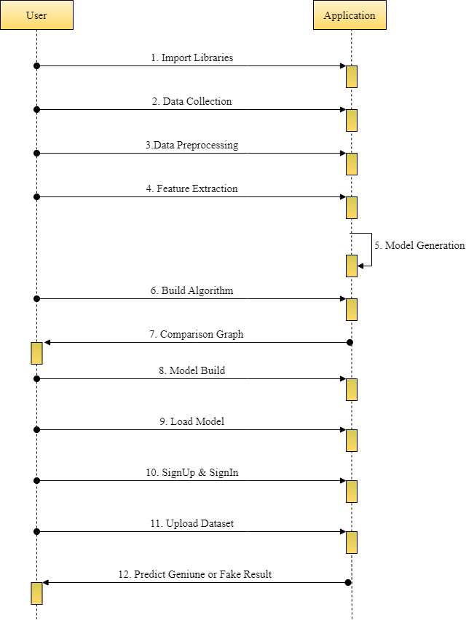
Sequence Diagram

Slide 18
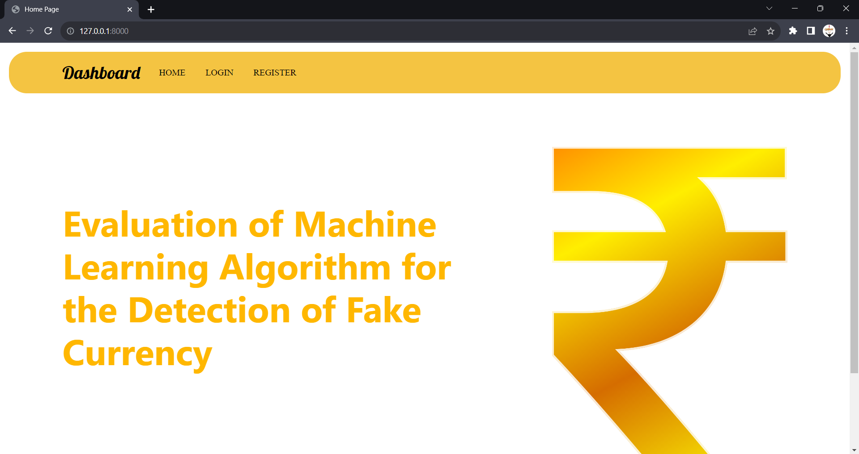
Form Design
HOME

Slide 19
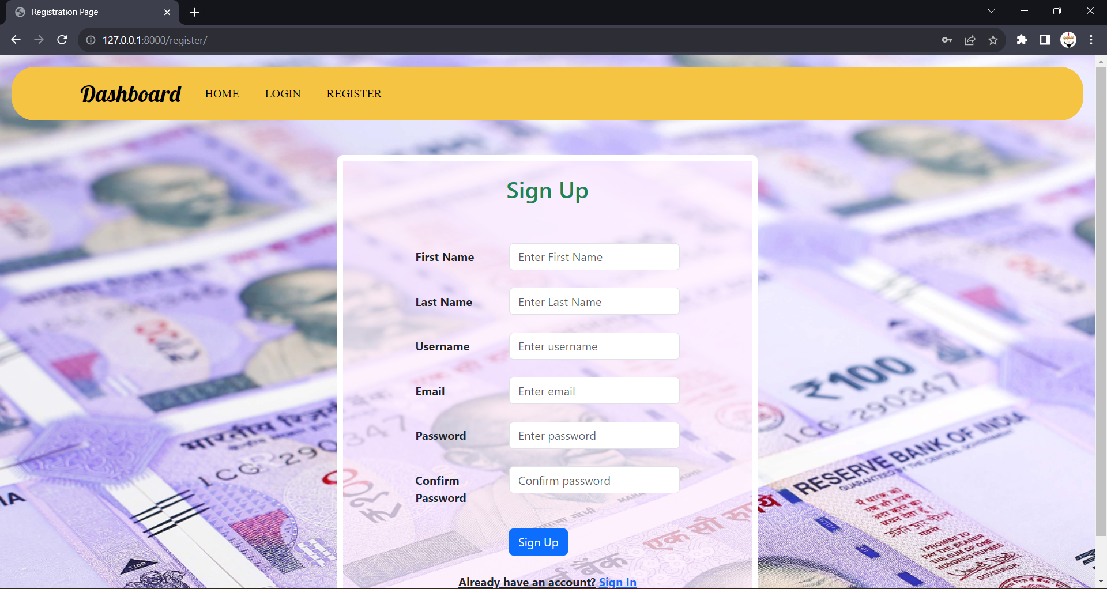
Registration Page

Slide 20
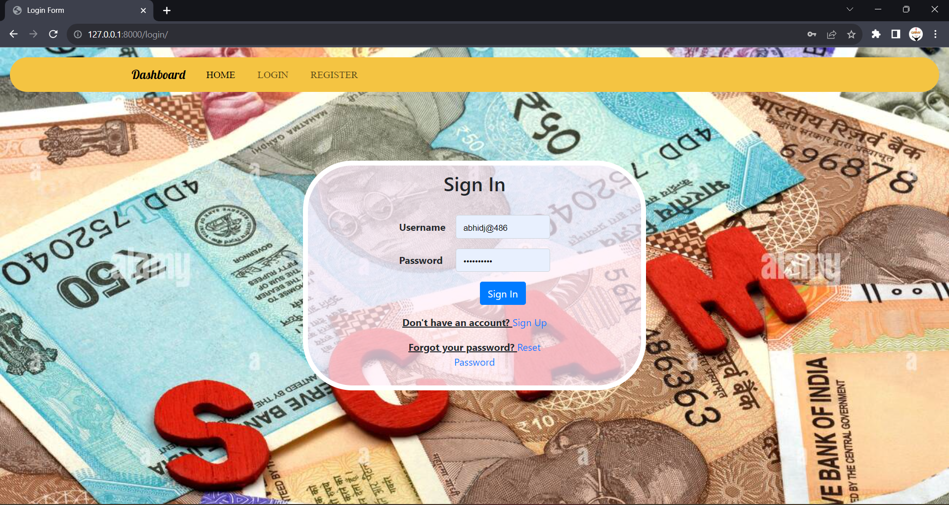
Login Page

Slide 21

User Home Page

Slide 22
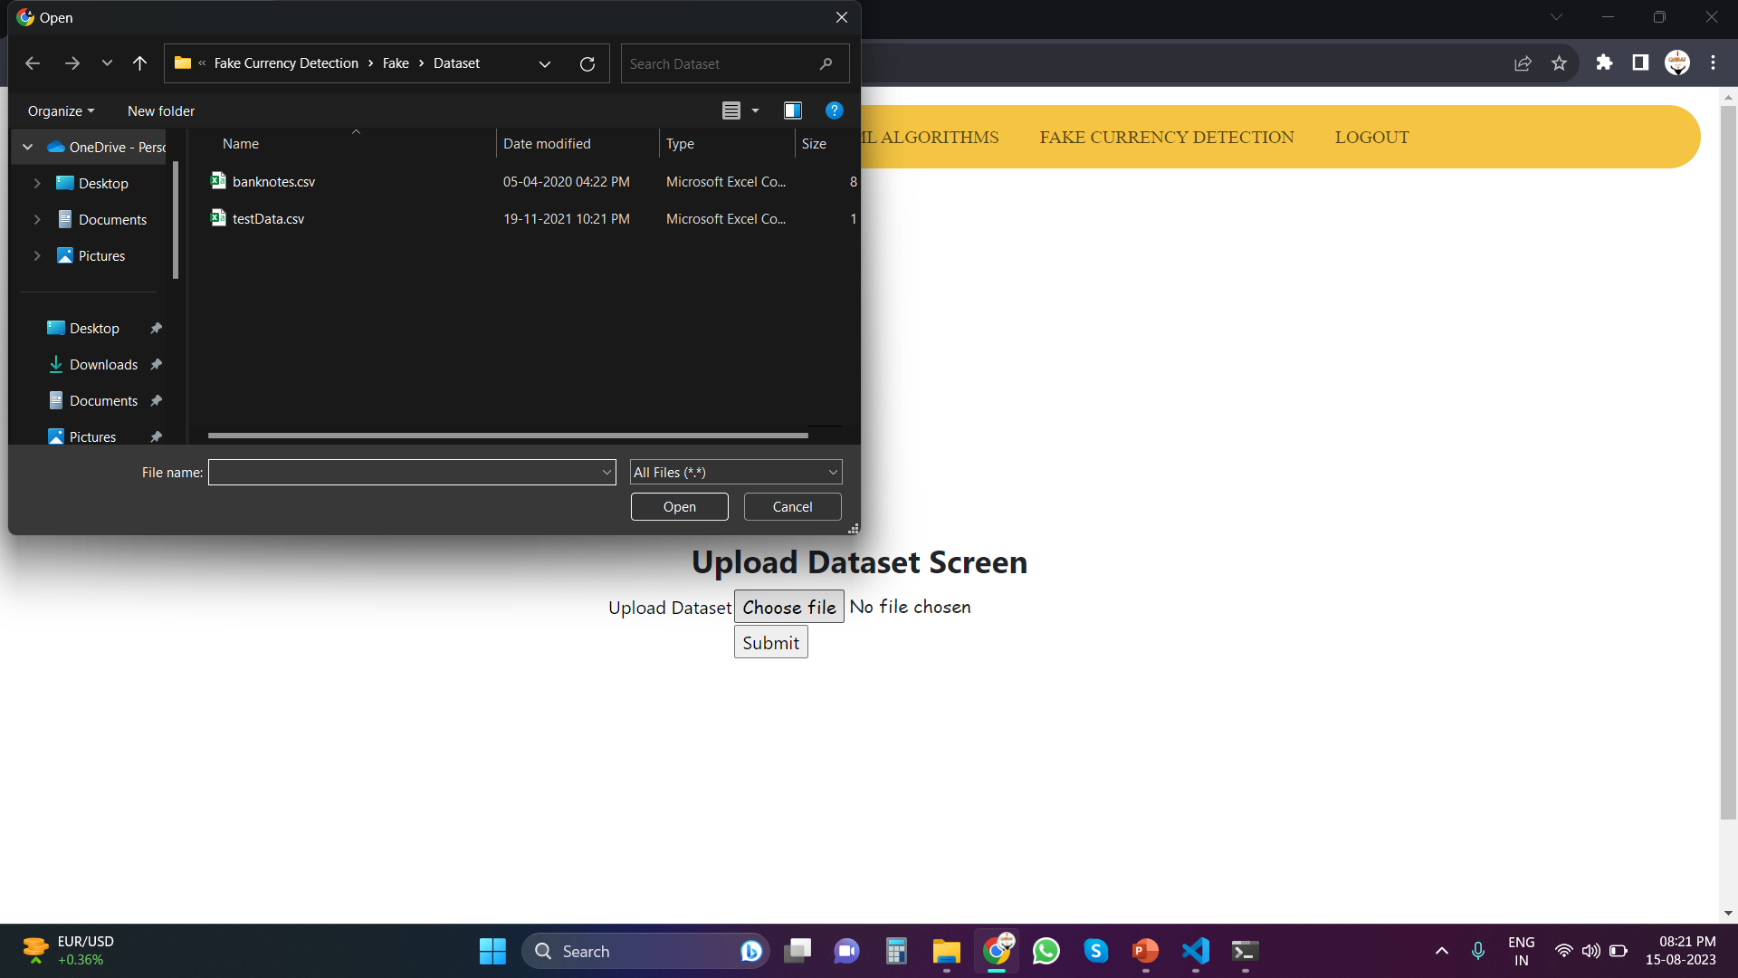
Upload Dataset

Slide 23
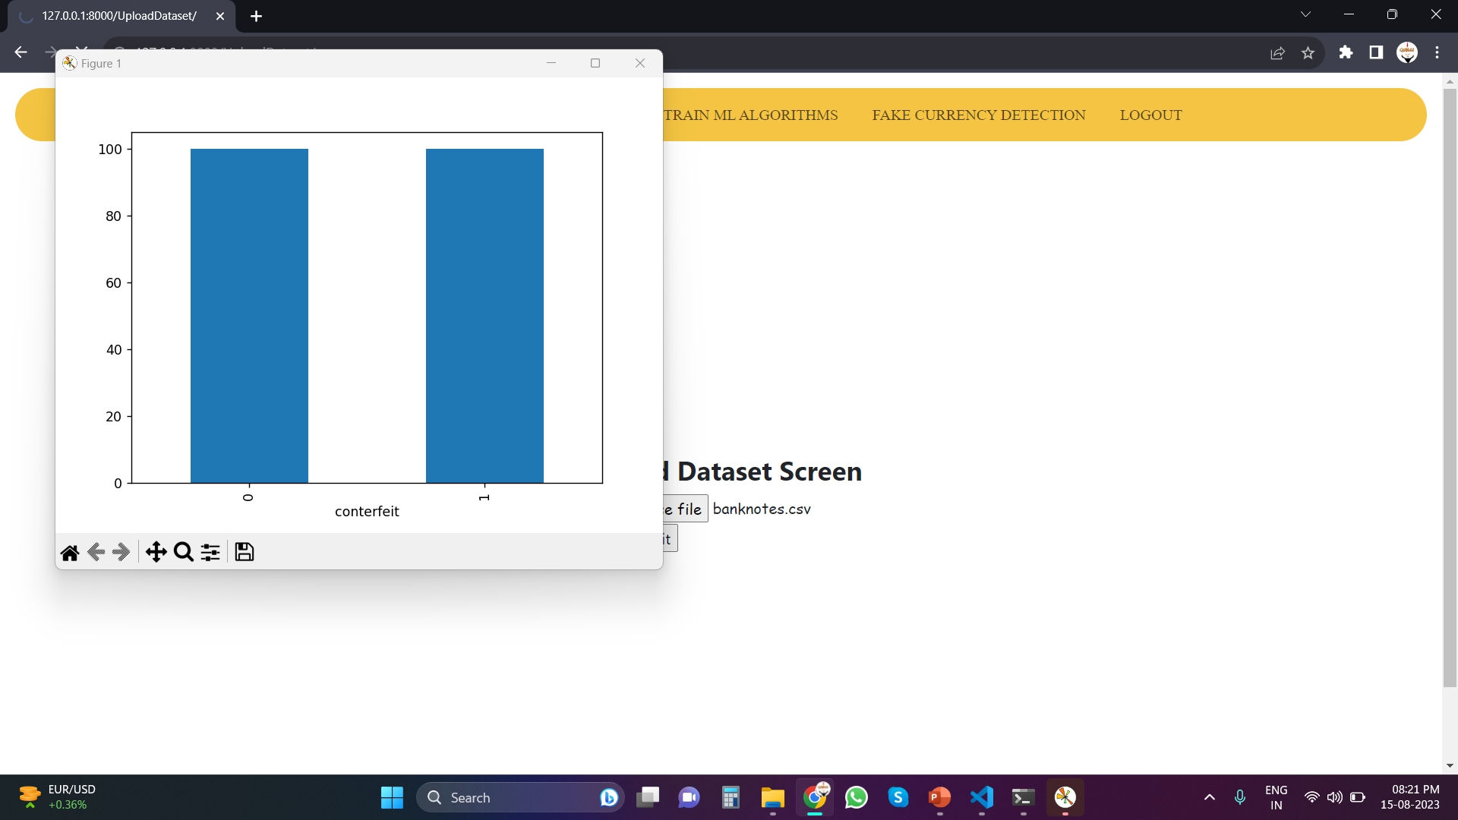
Classification

Slide 24
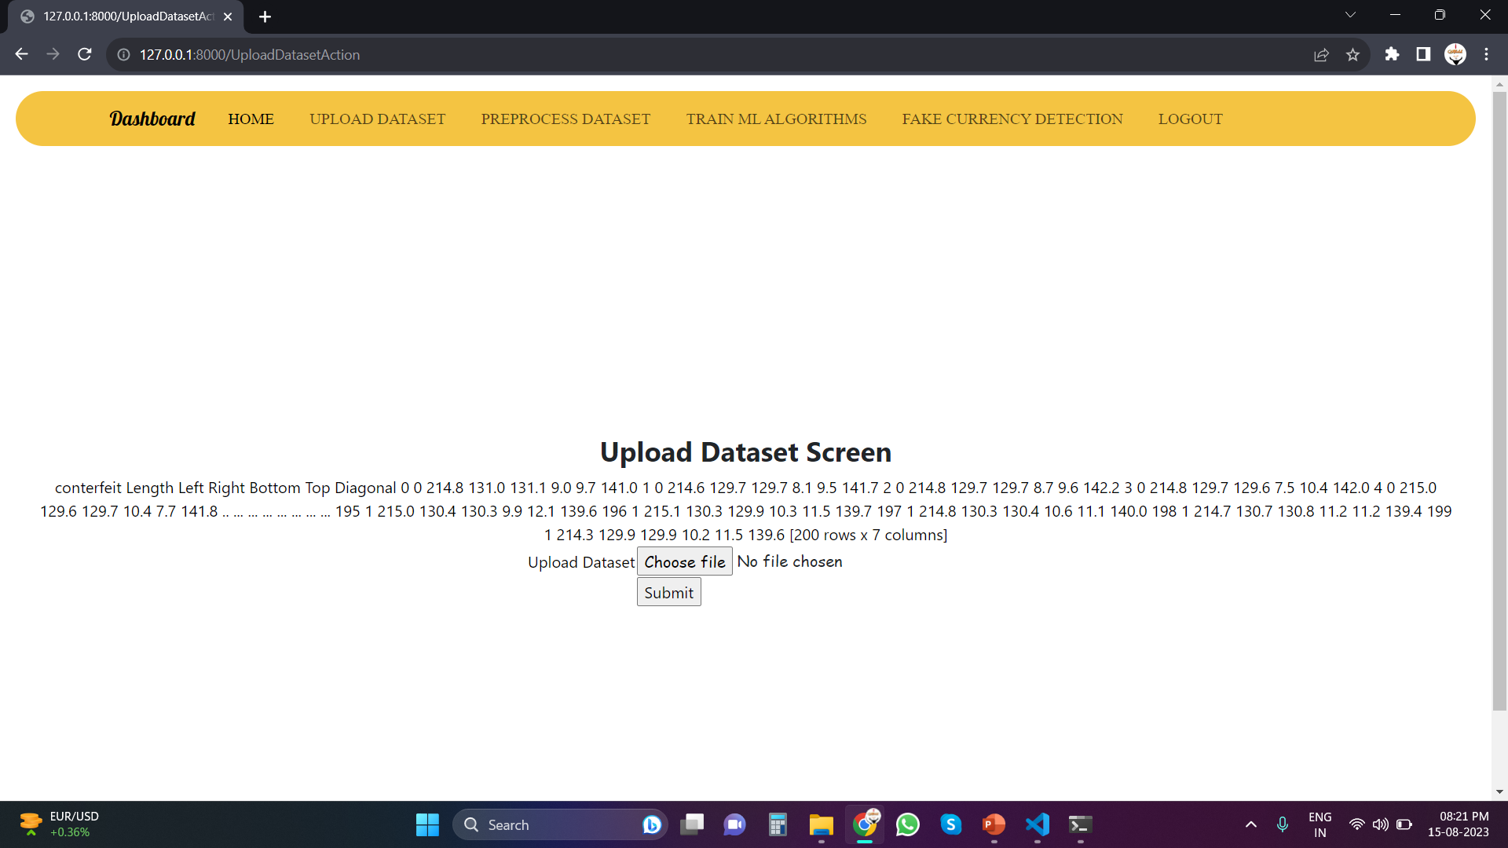
Extracted Features

Slide 25
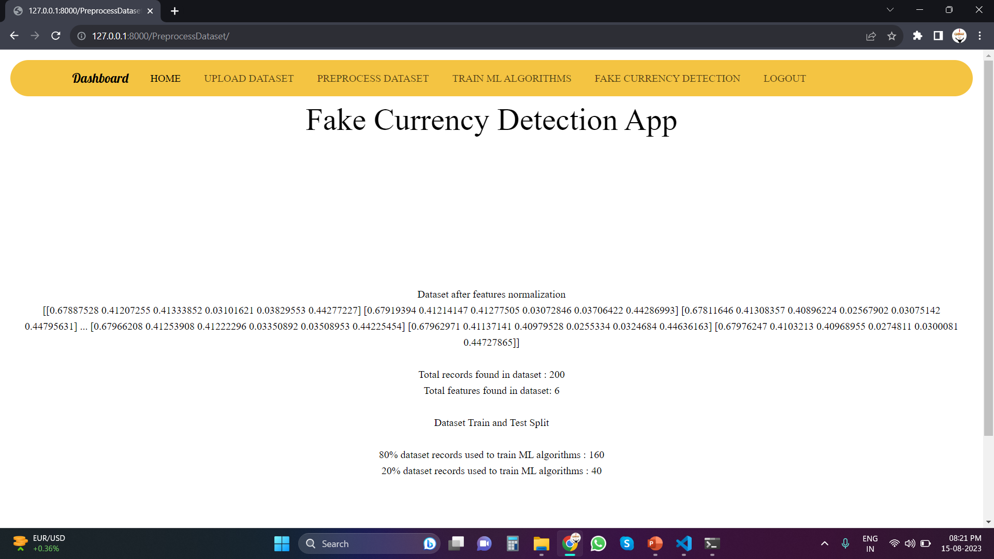
Pre-Process Dataset

Slide 26
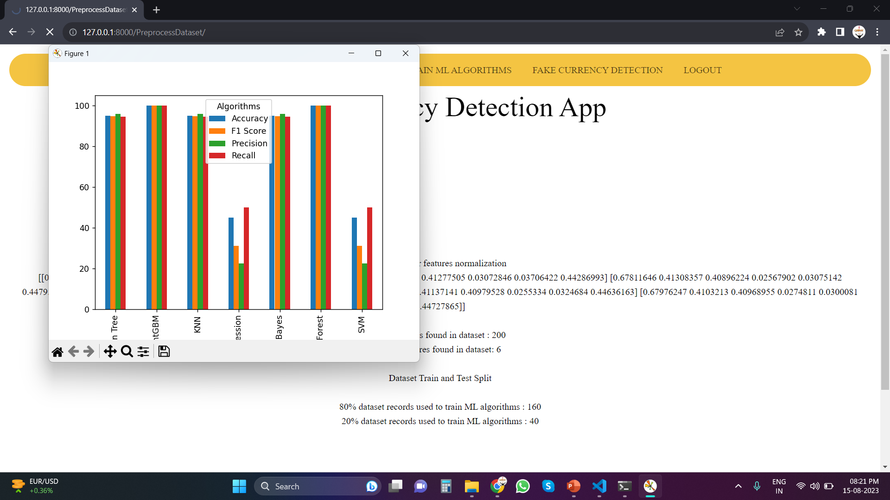
Algorithm’s Evaluation

Slide 27
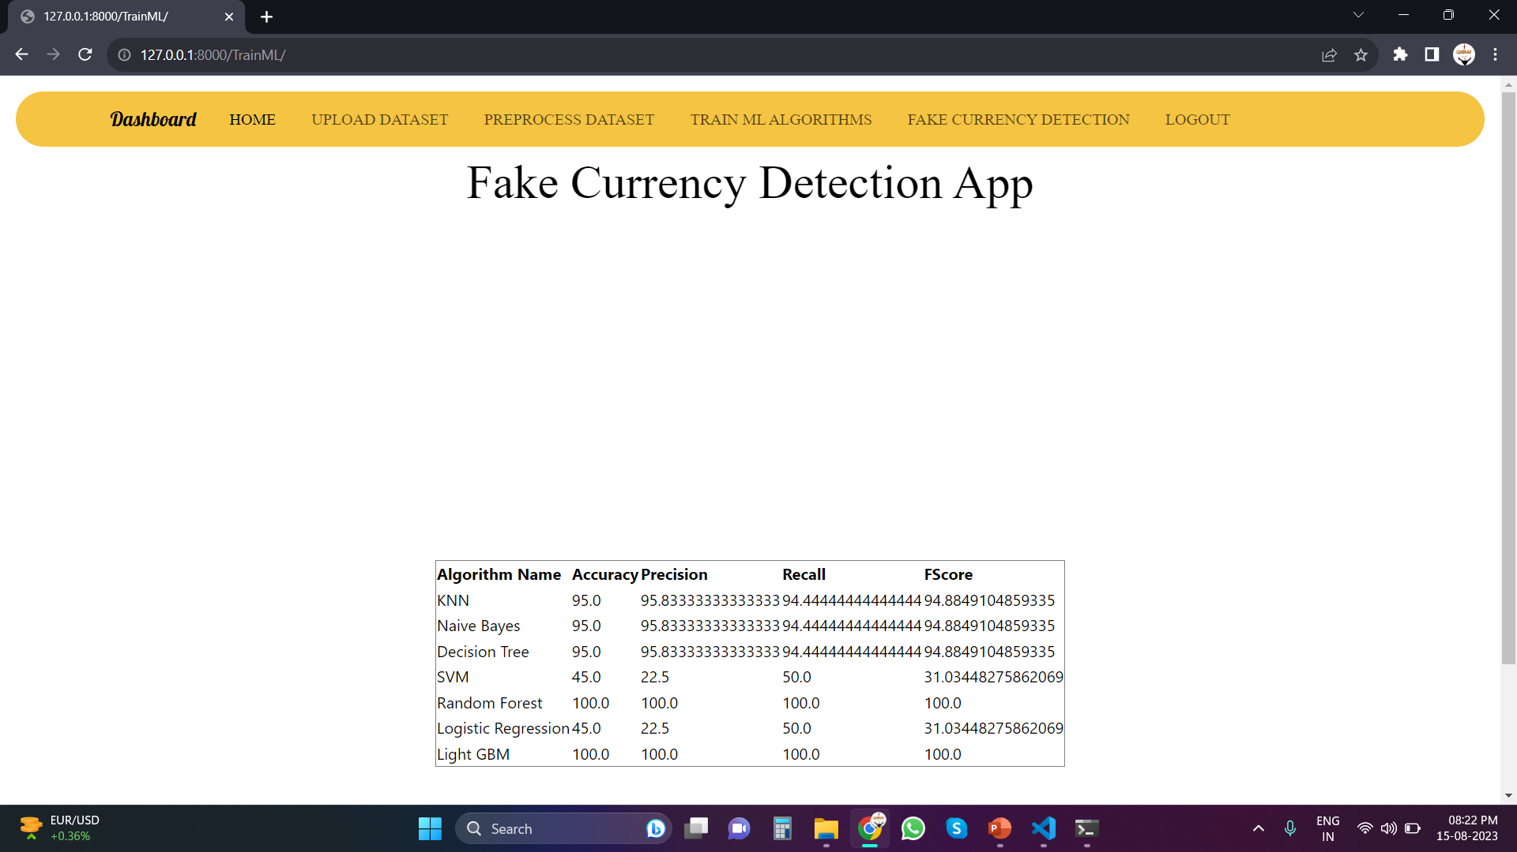
Algorithm’s Performance

Slide 28
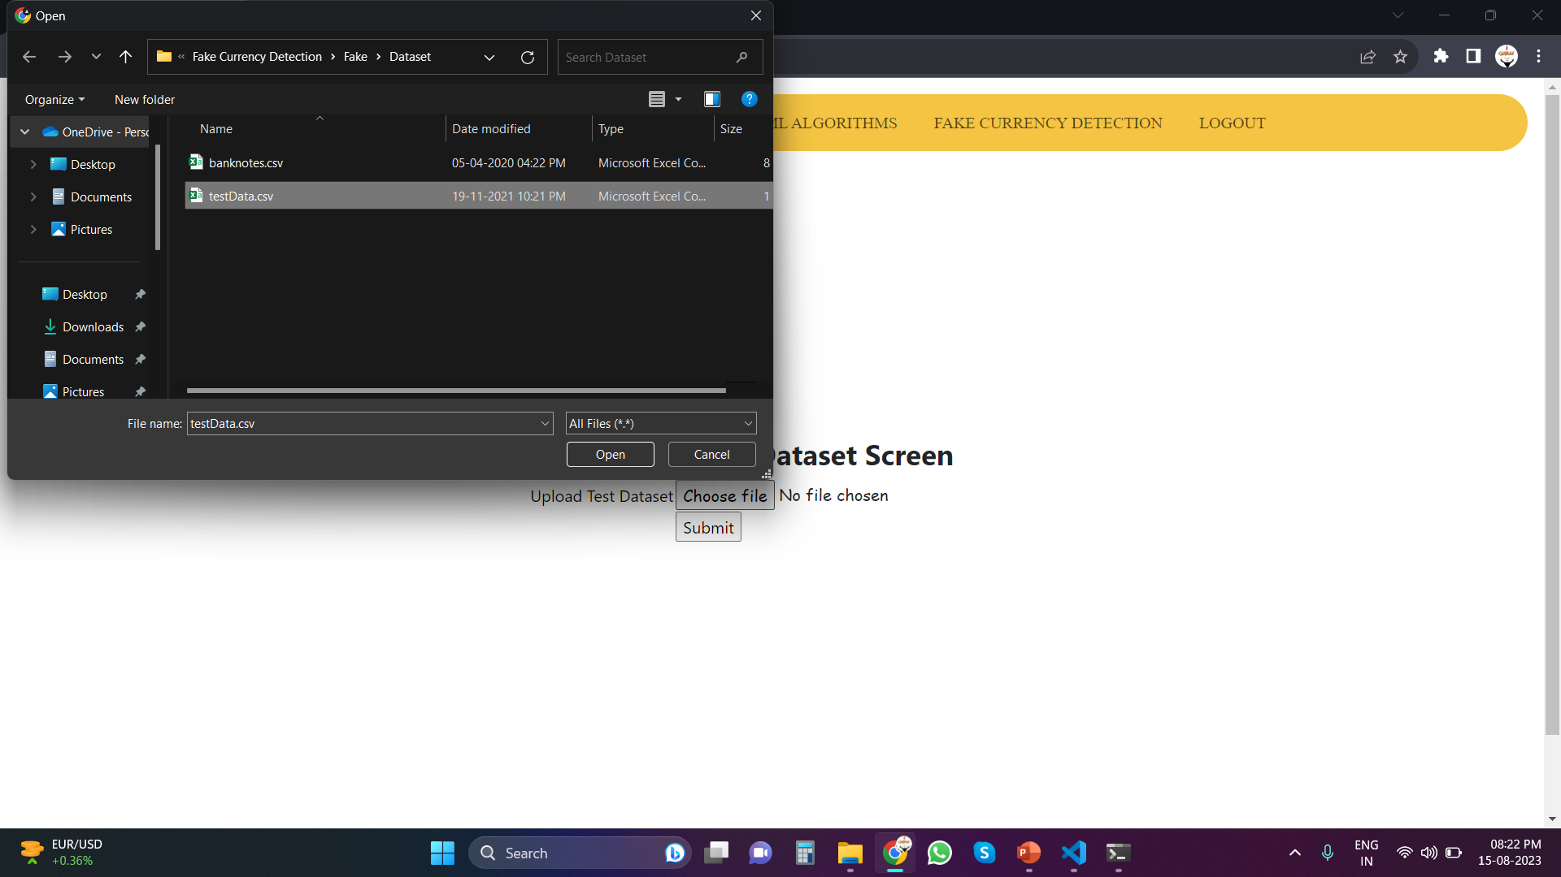
Upload Test Data

Slide 29
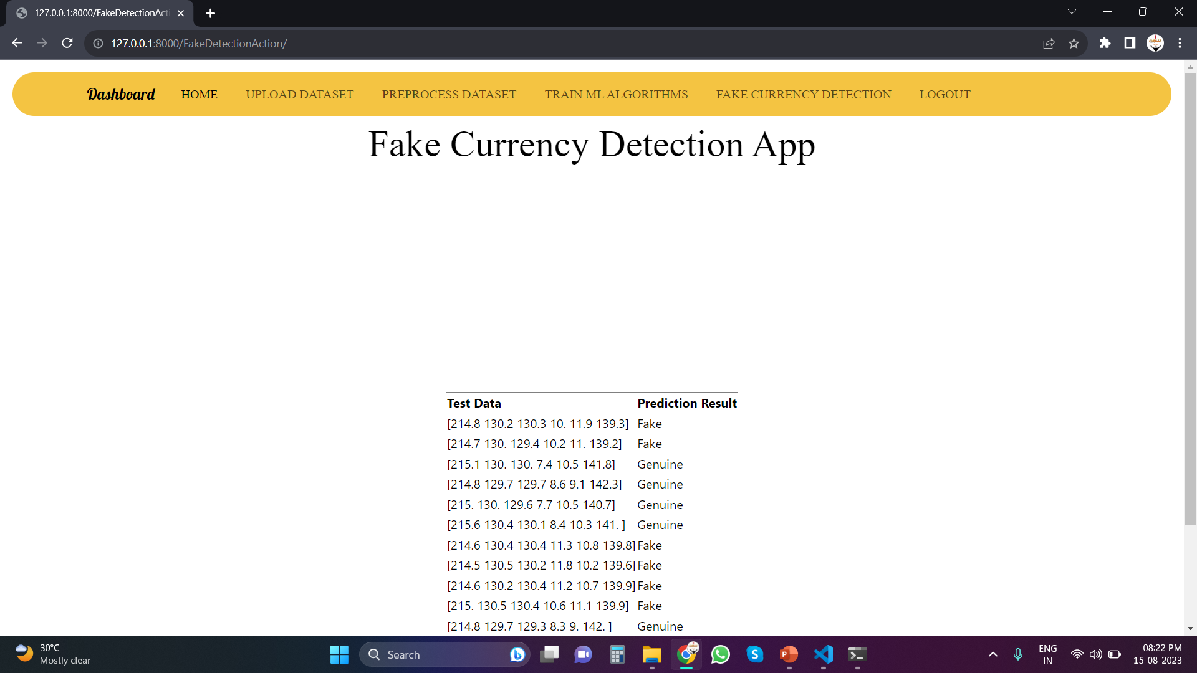
Final Prediction

Slide 30
Conclusion
In this study, I 'have conducted a comprehensive analysis of various machine learning algorithms applied to the banknote authentication dataset sourced from the UCI Machine Learning repository.
I 'have evaluated the performance of six popular algorithms, namely Support Vector Machine (SVM), Logistic Regression (LR), Naive Bayes (NB), Decision Tree (DT), Random Forest (RF), and k-Nearest Neighbors (KNN).
As an extension to this analysis, I 'have also introduced the LIGHTGBM algorithm, a gradient boosting framework, to further enhance prediction accuracy.
In Conclusion, these findings emphasize the importance of algorithm selection and parameter tuning in achieving optimal predictive performance.

Slide 31
Thank You

